Slide 1
Capstone Project - Location based Taxi Aggregator and Selector
IITM- Dec21 – Cloud Group 2
Binay Ranjan Sahoo
Sarath Kumar Raju
Pawan Ahuja

Slide 2
Introduction
The CabMe is a taxi company wants to build a competing solution to existing cab aggregators while keeping the power in the hands of users and drivers. We are helping the taxi company to build their backend technology platform.
The system is developed to store real-time cab locations, respond to demands from customers based on proximity matches with available drivers. The whole solution is running on AWS Services (EC2, API Gateway, Lambda, SNS) and MongoDB.

Slide 3
Requirement and Solution description
This setup will run in a specific area, implemented in this project. This is being assumed that the users and Taxis who are registered are within a specific area defined under Geospatial service with a Lat/Long. A simulator program which run on a EC2 will register 50 approx. taxis registered of different types i.e., Luxury, Basic, Deluxe, Utility and 5 Users. There is process using the lambda function (RegistrationLambda) as well, to register each new taxi, with a unique taxi id and their type and sends a notification to the driver using SNS. Similarly, the same lambda function is being used to register a user with a unique user id. Once registration is complete a confirmation email will be sent to the user using SNS.
Each taxi will transmit its location (Lat/Long coordinates) periodically (at least once per minute). There is a simulator which is running on EC2, increments the taxi coordinates to show the taxis are moving slowly. MongoDB is being used to store the geo coordinates because of the geo-aware feature.
Each user can make a request for a taxi at any time. There is an API for user, to raise a taxi request. API will use the Lambda function (CabBookingLambda) to find the nearest taxi using geospatial features of MongoDB, book the taxi and respond with the details of the confirmed Taxi to the user and same time the details of the user to the Taxi Driver as well using the SNS notification.
Once the Taxi is booked, there is an API feature for Taxi Driver to start and end the trip through Lambda function (TripLambda). Once the trip is started the starting coordinates are captured along with the timestamp and a notification to the user and taxi driver will be sent using SNS. While ending the trip, end coordinates are being updated when trip is ended by the driver and again a notification to the user and driver will be sent through SNS. Duration of the trip is updated into the table as well. These specific data are gathered and can be used for the future analysis purpose.

Slide 4
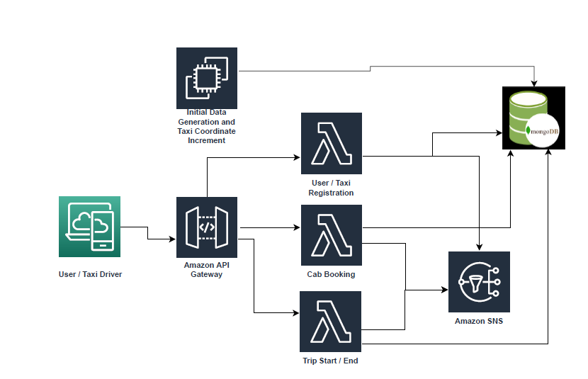
Component Design

Slide 5
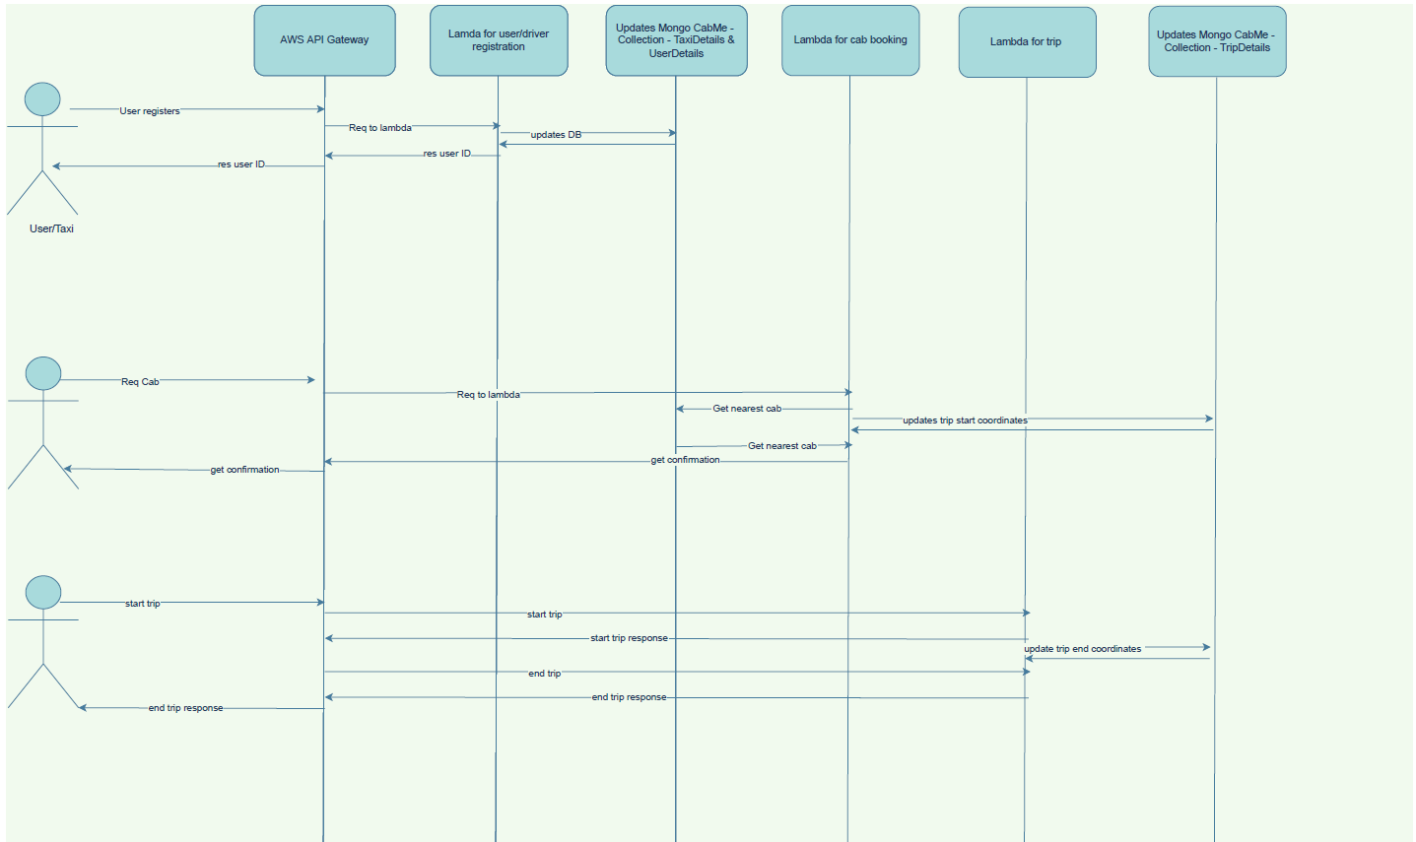
Action Flow Diagram

Slide 6
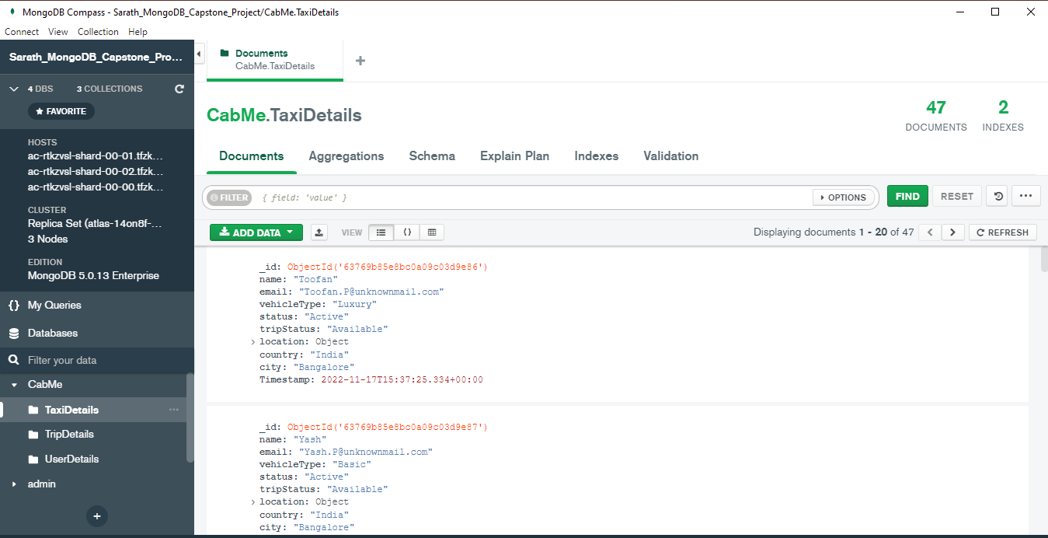
Simulated Bulk Taxi and User Registration
A simulator program named setup.py, running on EC2 registers 50 taxis and 5 users as a bulk. A specific area is assumed as the boundary of this taxis and User Registration.
Screen Shot of MogoDB after User Registration:

Slide 7
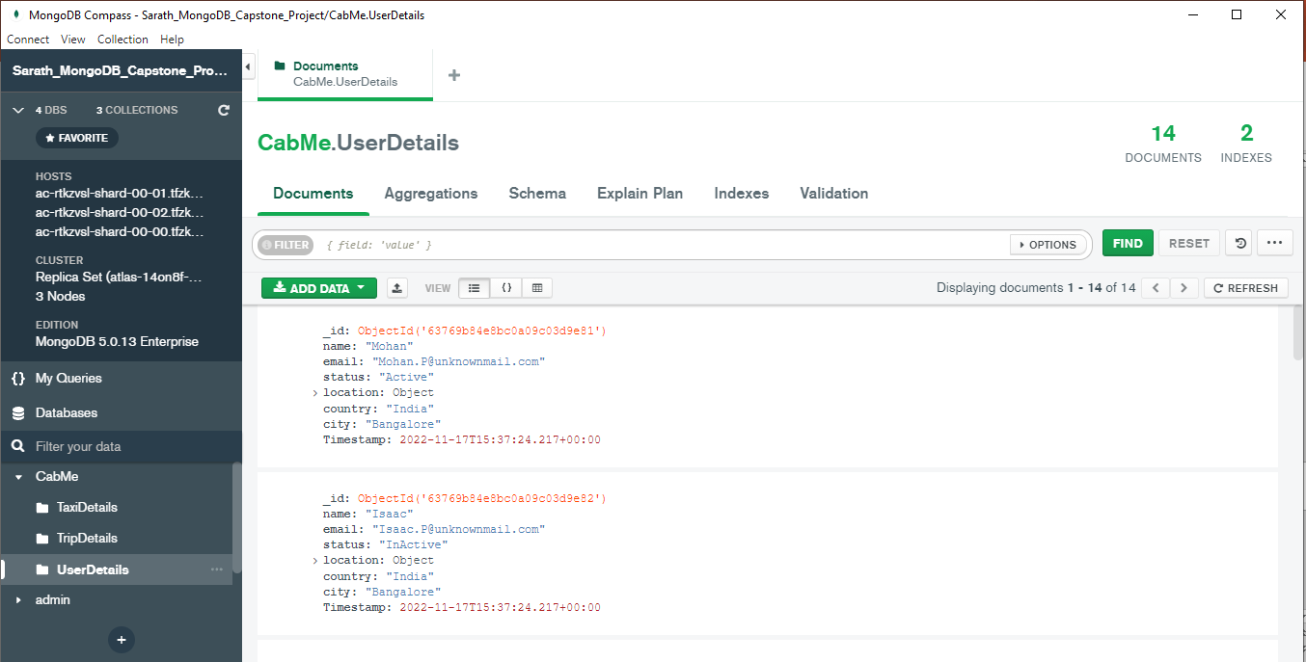
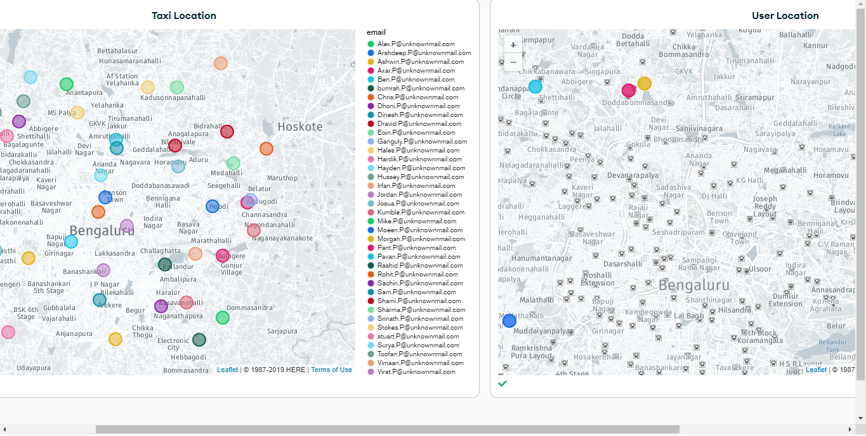
User Details, Taxi and User Location map
User Details in MongoDB
Taxi and User Locations in the map

Slide 8
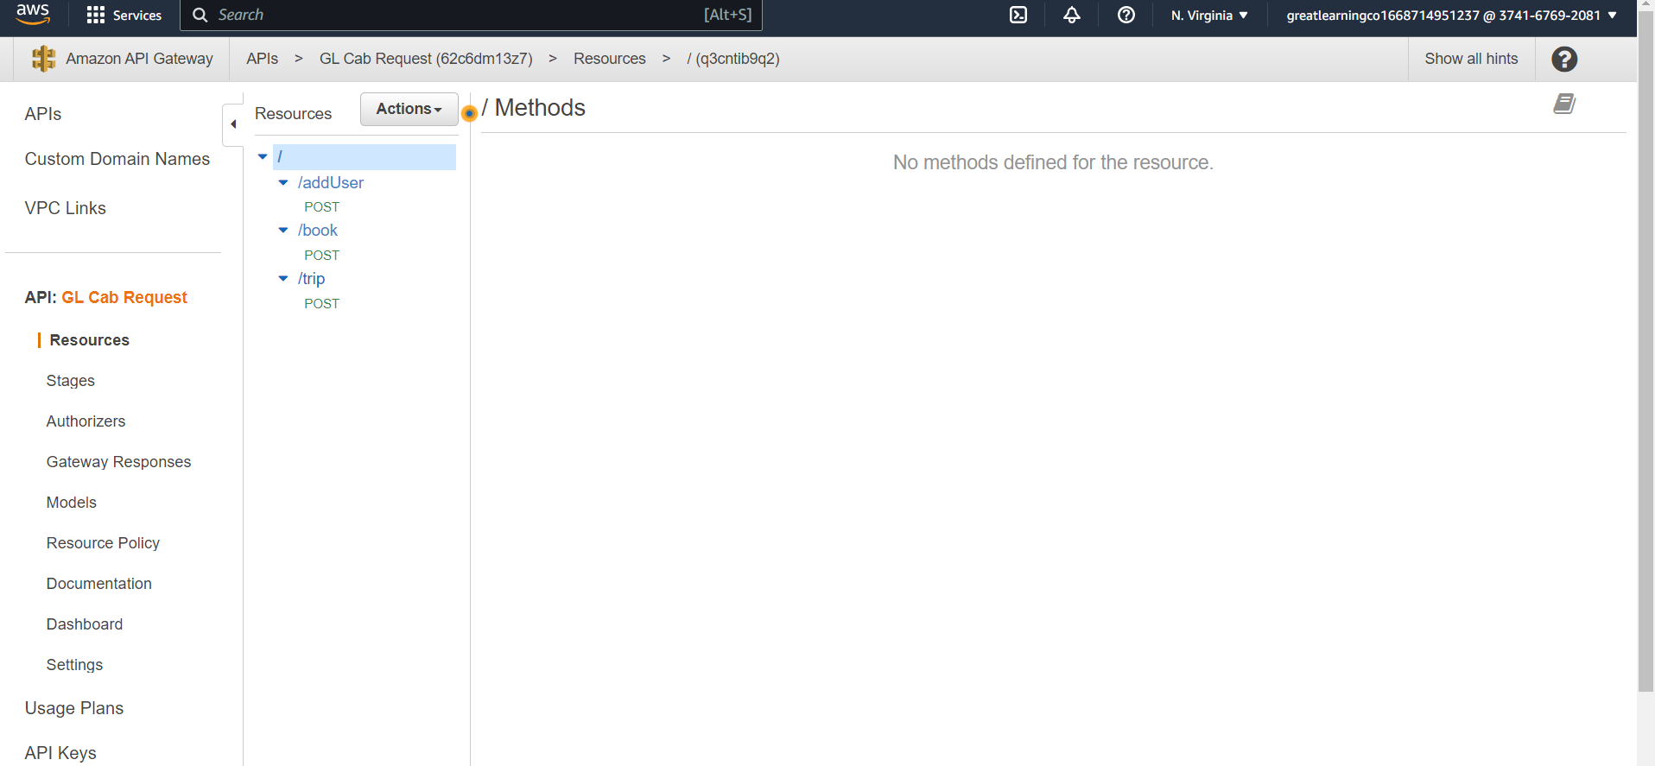
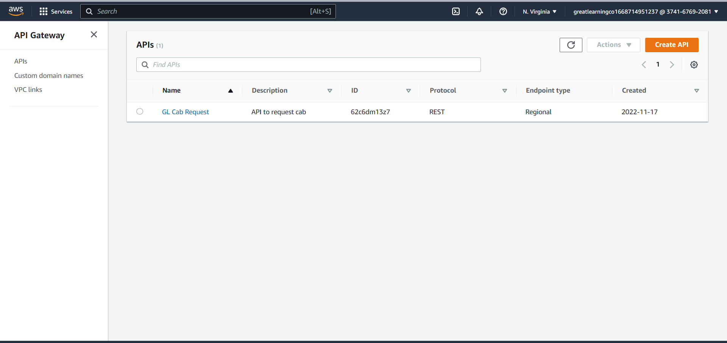
API Gateway

Slide 9
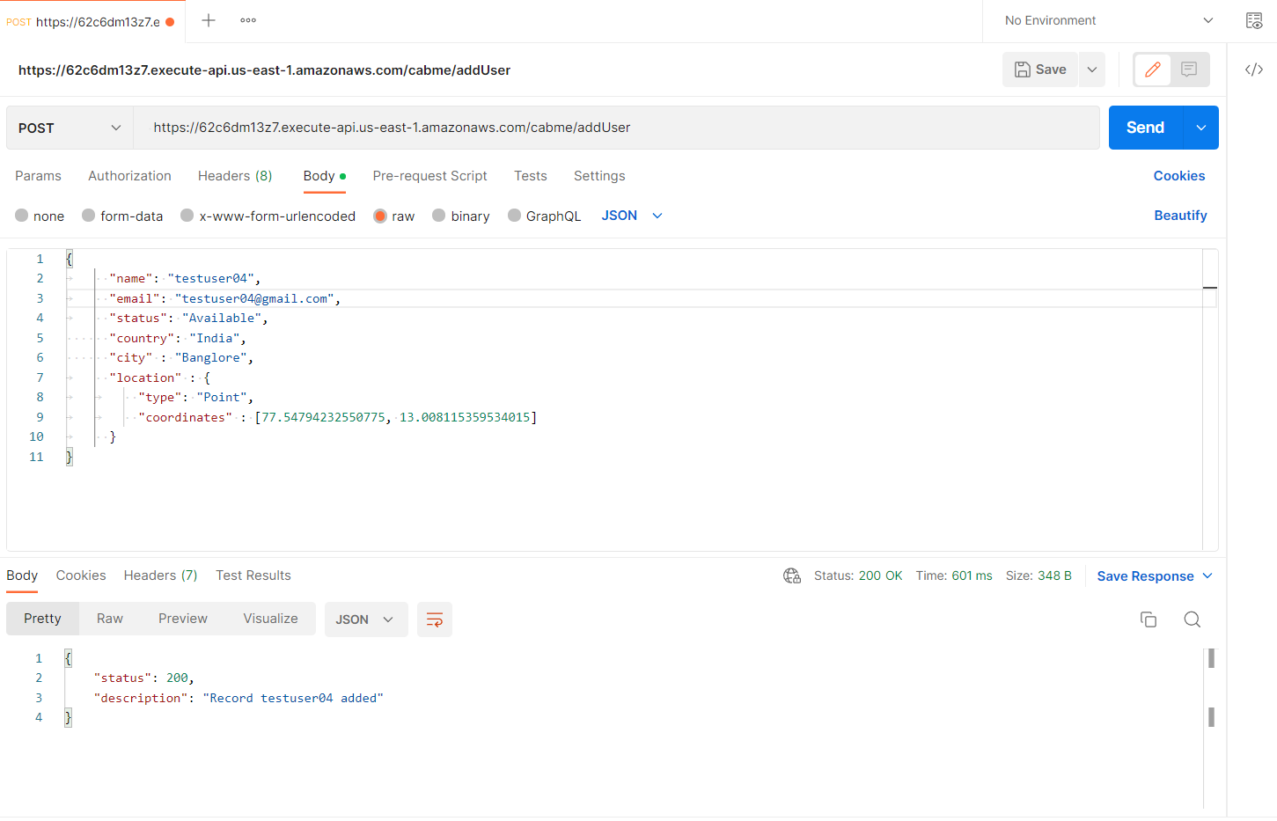

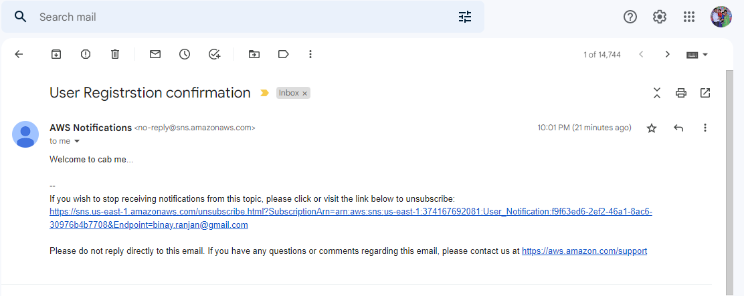
User Registration
User Registration Request
User Validation
Confirmation Email

Slide 10
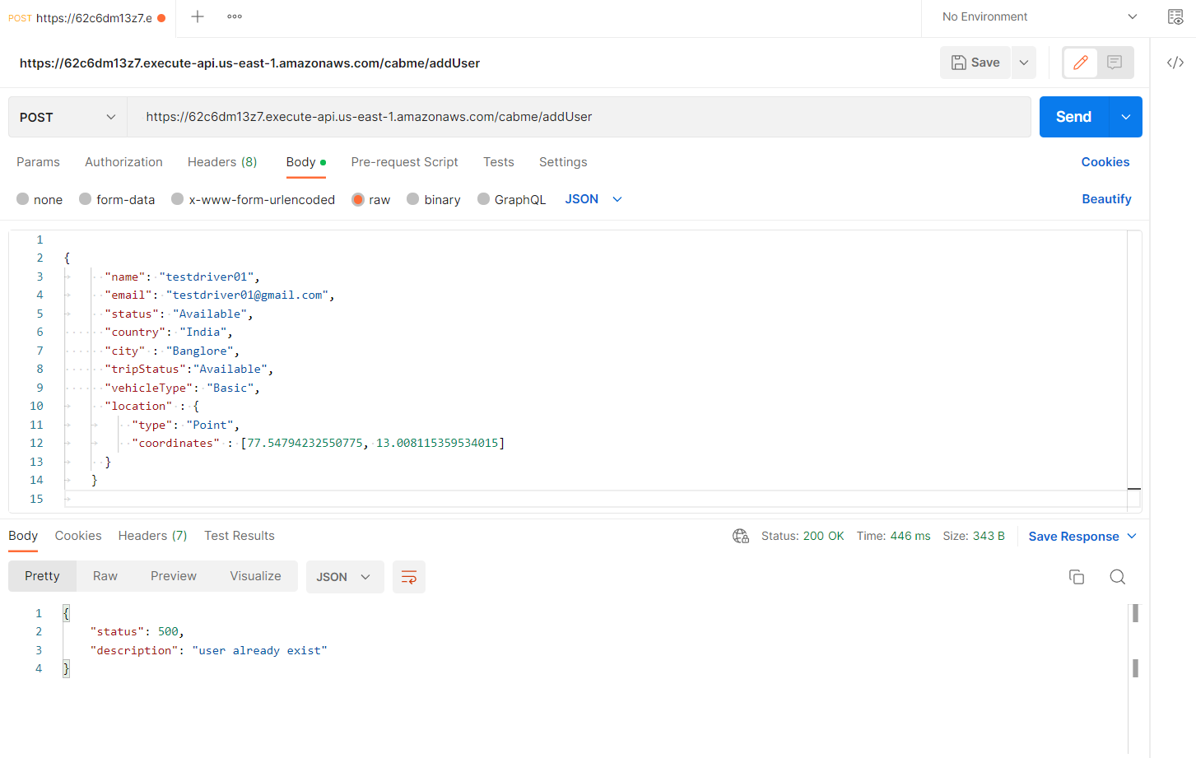
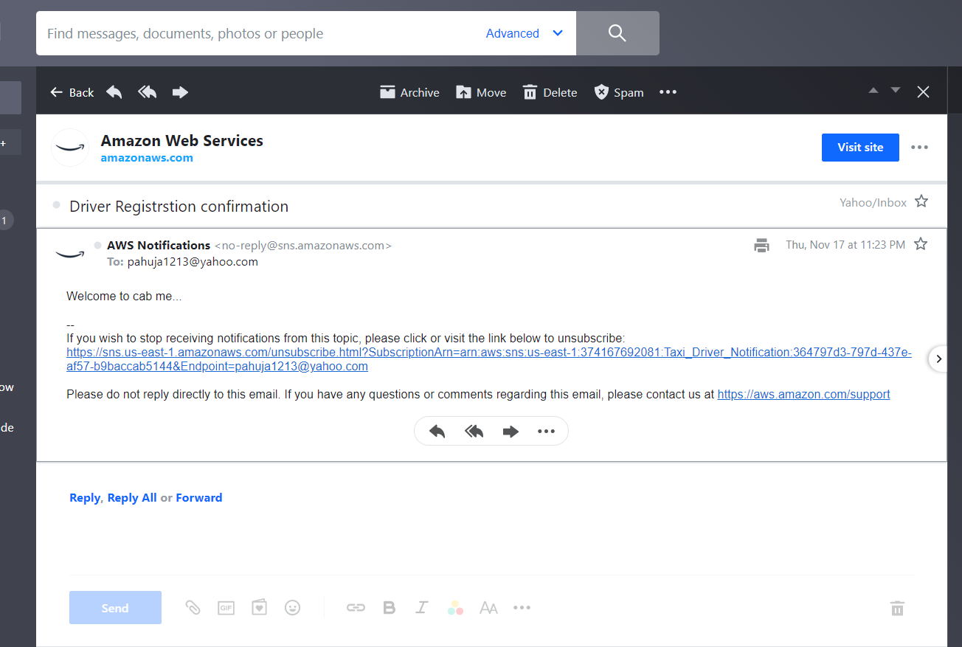
Taxi Registration
Taxi Registration request
Confirmation Email

Slide 11
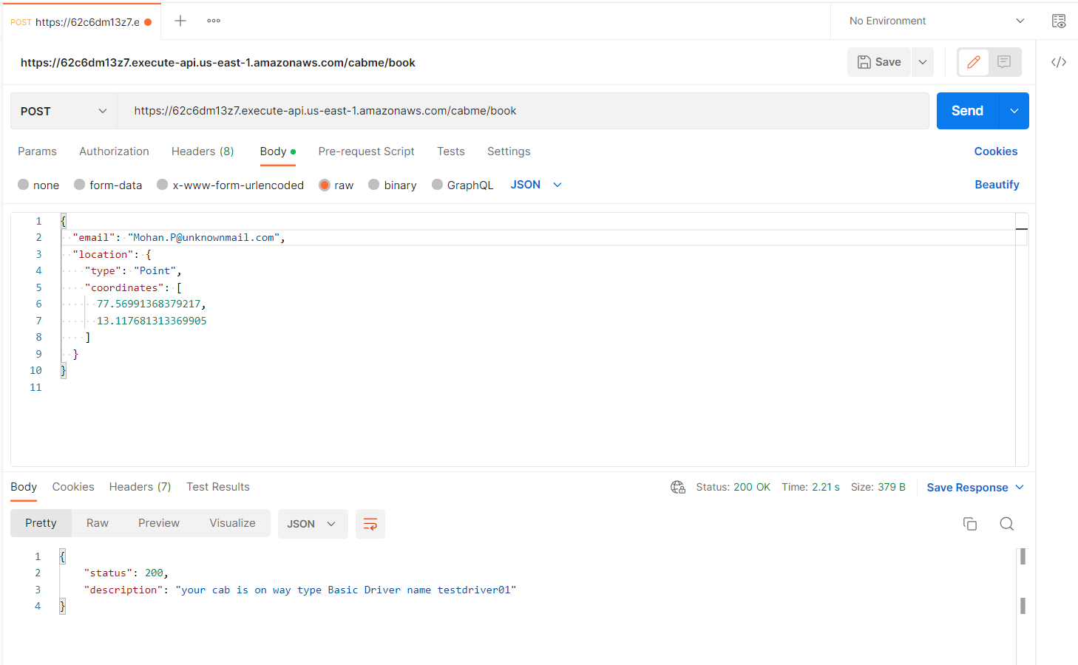
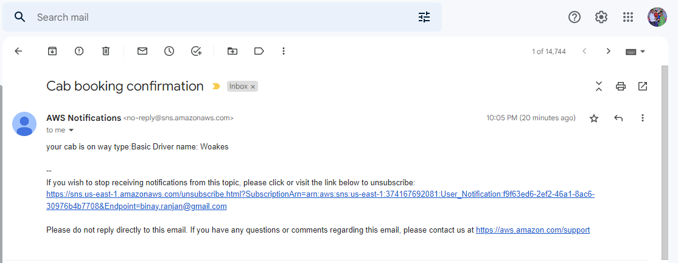
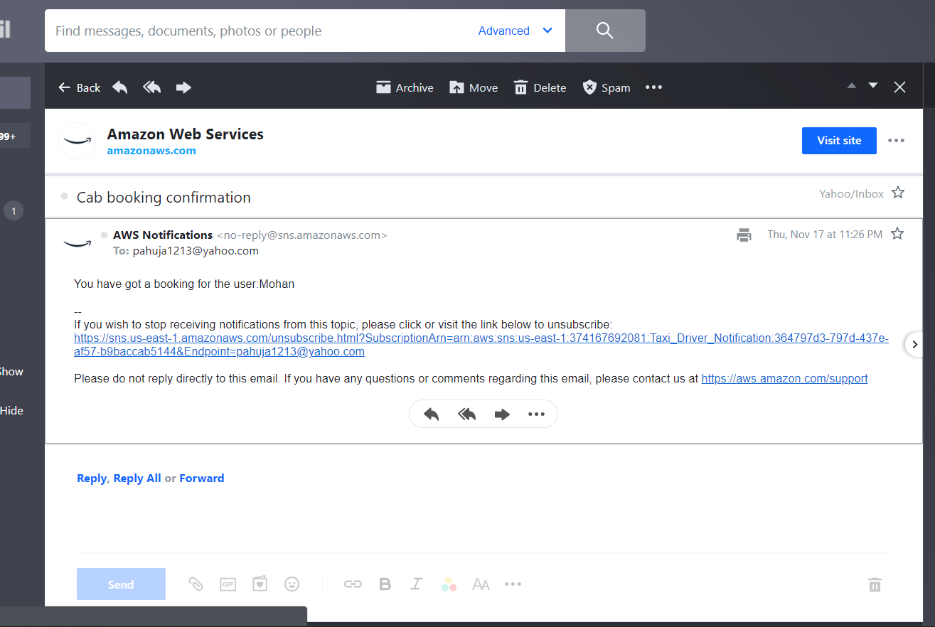
Taxi Booking
Taxi Booking
Confirmation Email - User
Confirmation Email - Driver

Slide 12
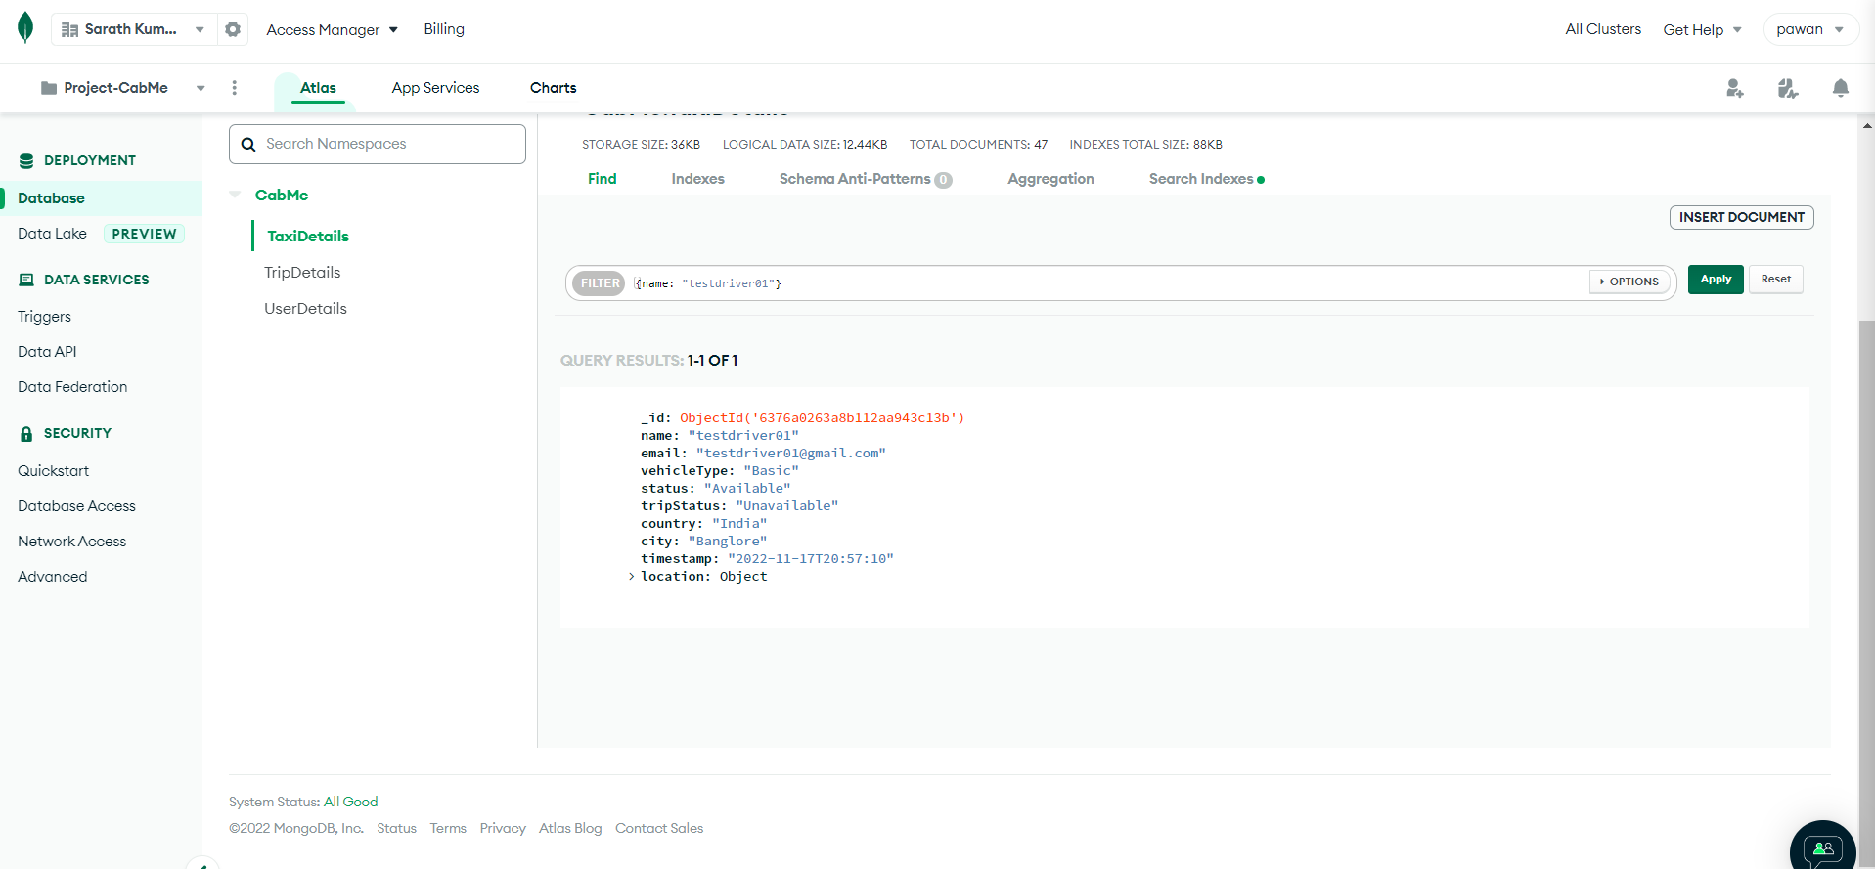
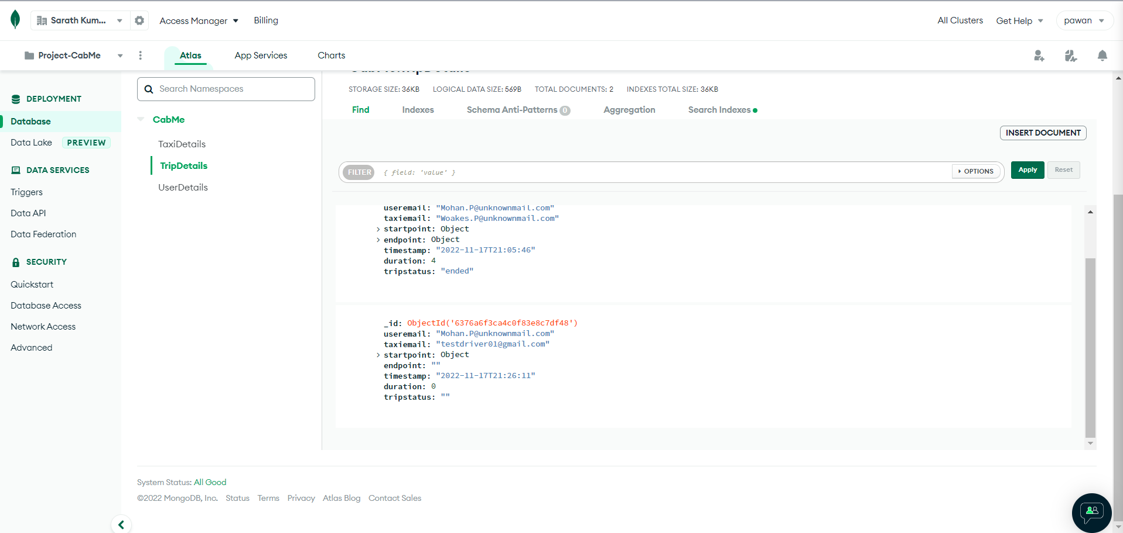
Taxi Details Table and Trip Details Table Updates
tripStatus in TaxiDetails Become s unavailable
useremail, taxiemail and timestamp updated in TripDetails collection

Slide 13
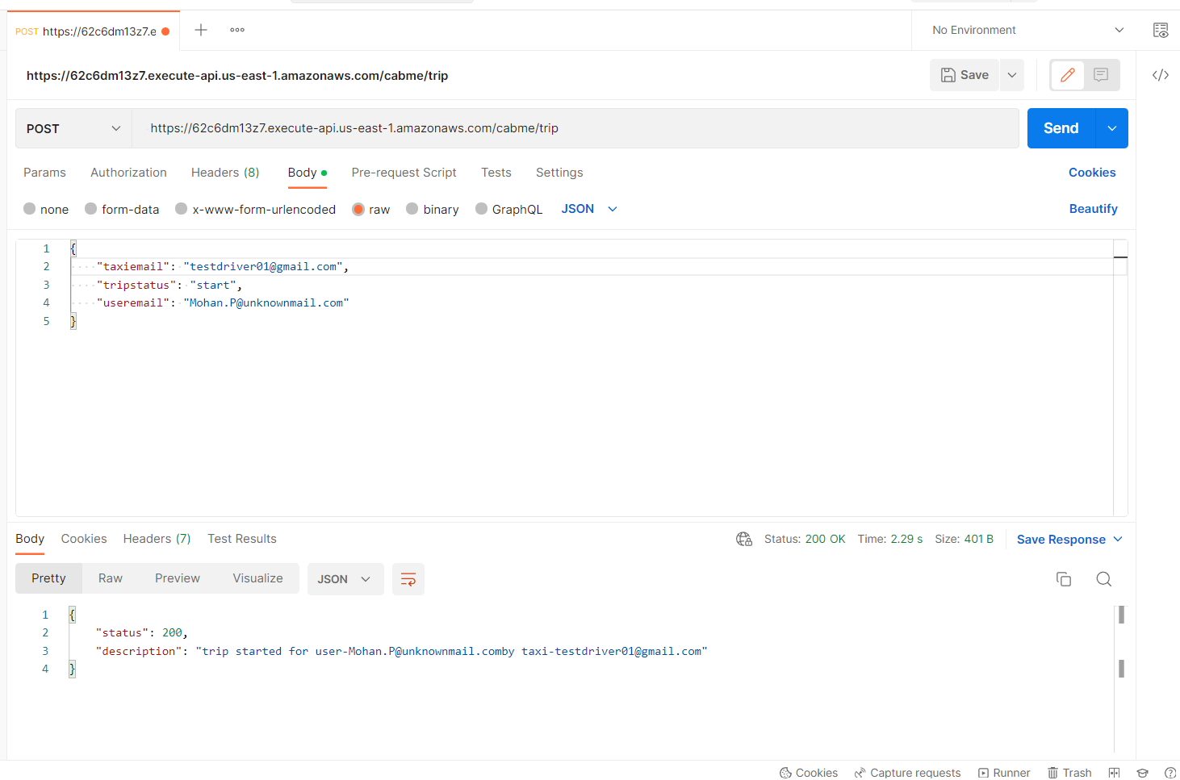
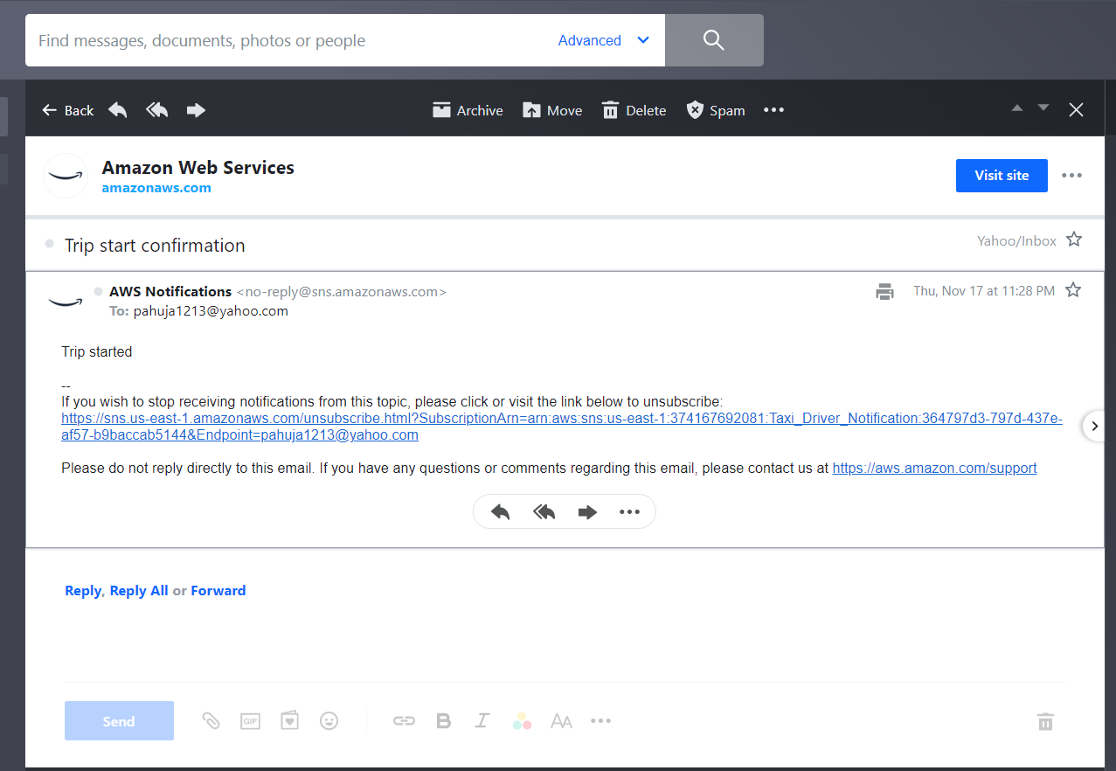
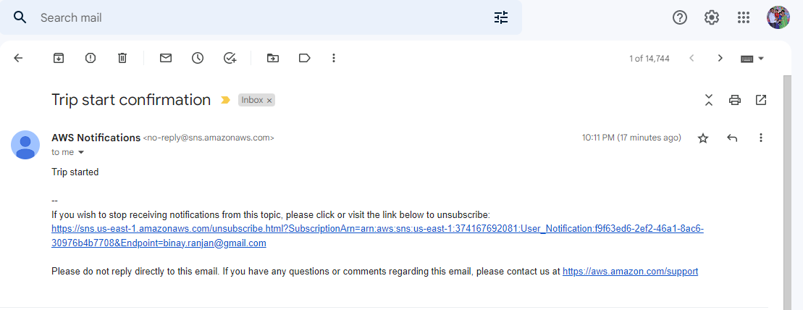
Trip Start By Driver
Trip started by Driver
Trip start Notification - Driver
Trip start Notification - User

Slide 14
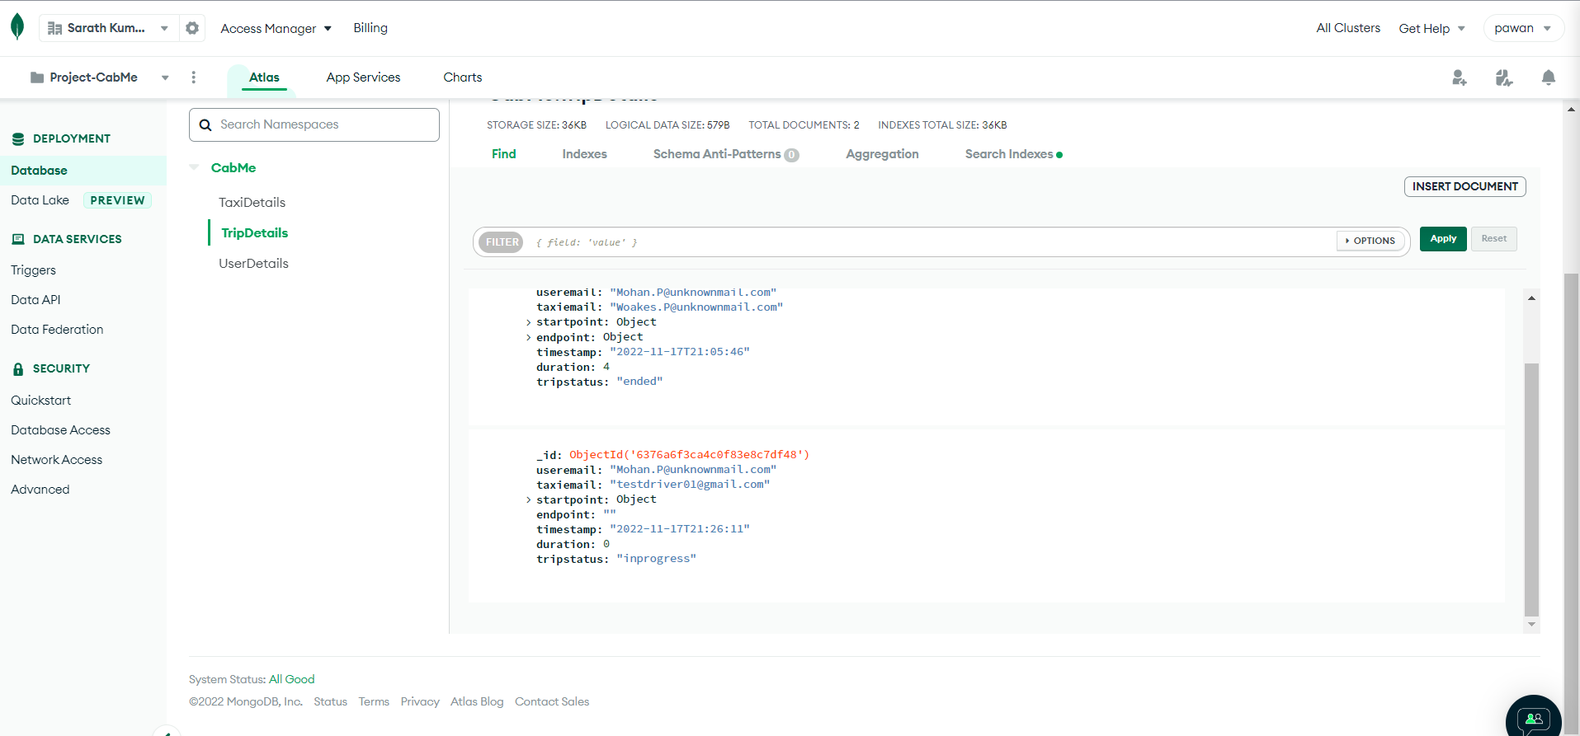
TripStatus Update in TripDetails Collection
tripStatus updated as “inprogress” once trip is started by the driver

Slide 15
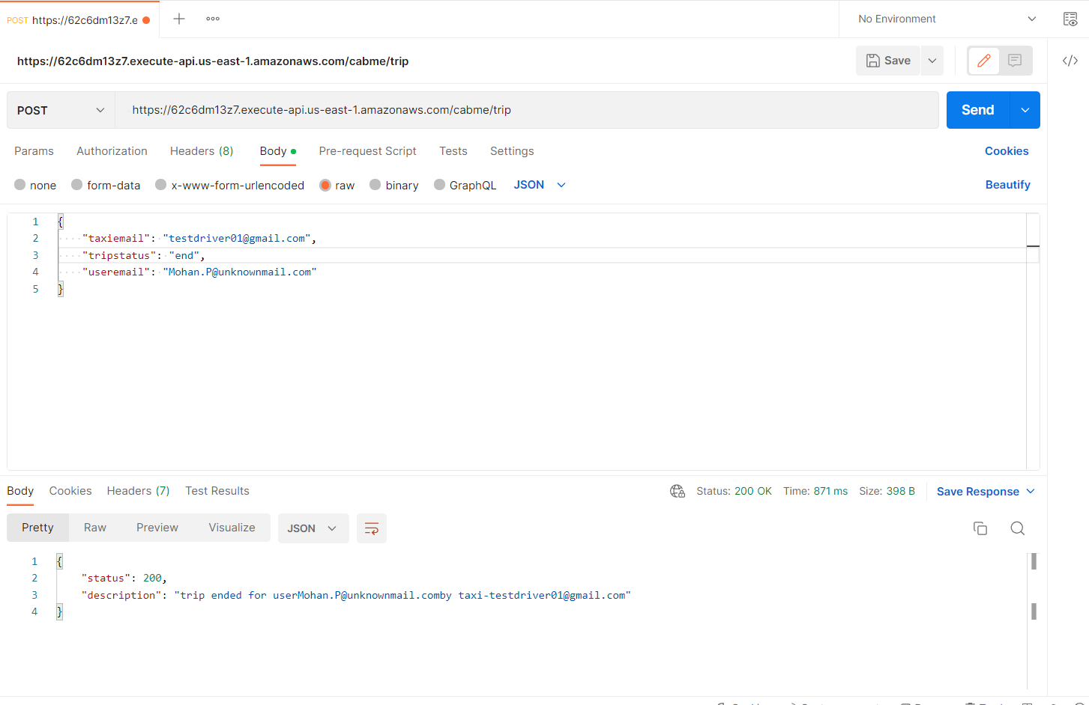
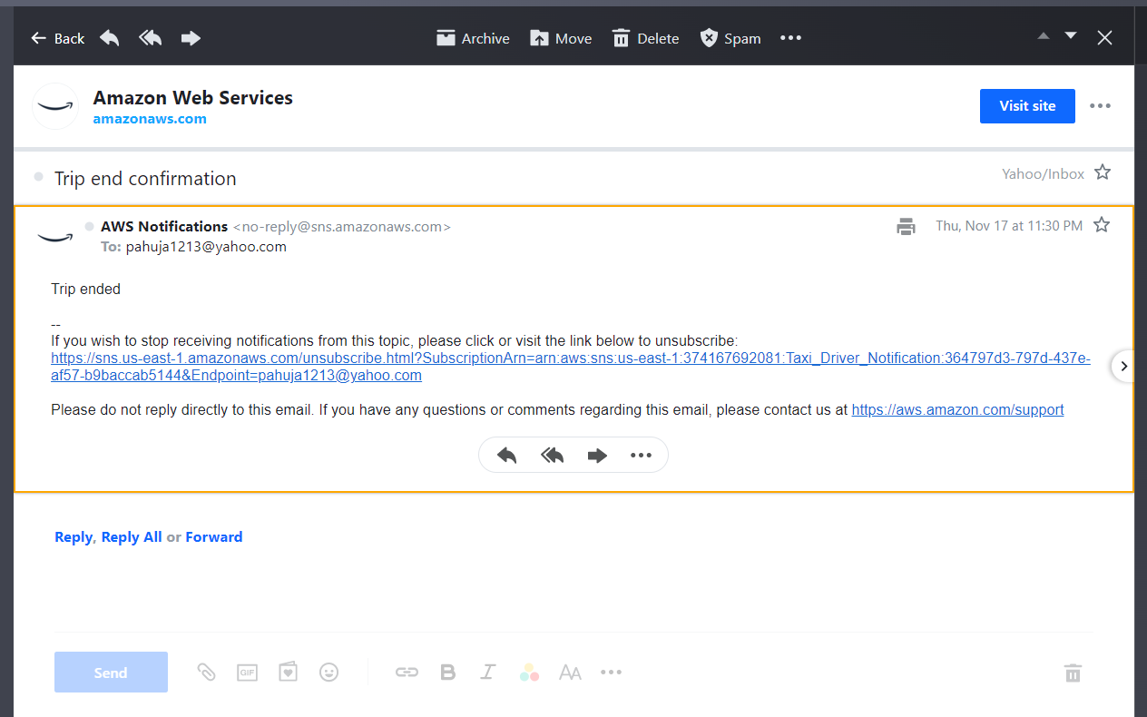
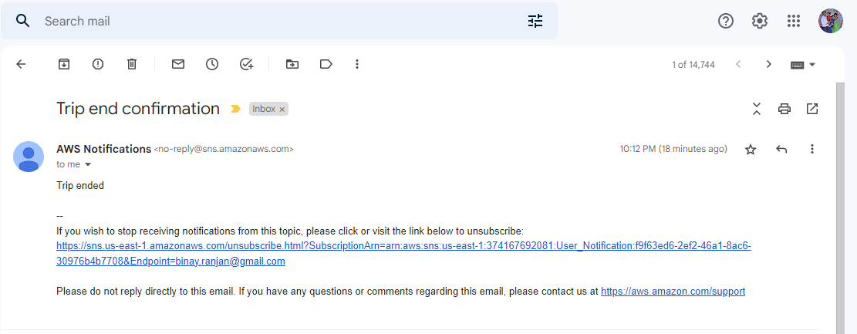
Trip End by Driver
Trip Ended by Driver
Trip End Notification - Driver
Trip End Notification - User

Slide 16

Trip Status and Duration Update in TripDtails collection
tripStatus updated as “ended” and duration is captured once trip is ended by the driver

Slide 17
DEMO

Slide 18
Thank You

